Slide 1

Geometry
Unit 9, Lesson 6 Finding Volume Volume 2, pg. 82

Slide 2


Benchmark
MA.912.GR.4.5
Solve mathematical and real-world problems involving the volume of three-dimensional figures limited to cylinders, pyramids, prisms, cones, and spheres.
volume 2, pg. 82

Slide 3
Integrated Mathematical Thinking and Reasoning Standards
MA.K12.MTR.2.1 Demonstrate understanding by representing problems in multiple ways.
MA.K12.MTR.3.1 Complete tasks with mathematical fluency.
MA.K12.MTR.4.1 Engage in discussions that reflect on the mathematical thinking of self and others.
MA.K12.MTR.5.1 Use patterns and structure to help understand and connect mathematical concepts.
volume 2, pg. 82

Slide 4

Learning Target
I can find the volume of spheres, prisms, cones, pyramids, and cylinders.
volume 2, pg. 82

Slide 5

Warm-Up
volume 2, pg. 83

Slide 6
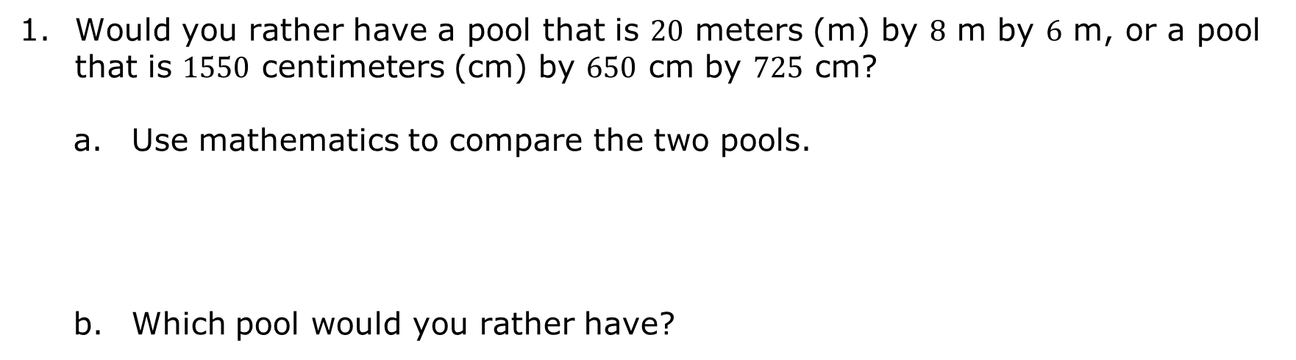
9.6.1 Warm-Up: Would You Rather?
Would you rather have a pool that is $20$ meters (m) by $8$ m by $6$ m, or a pool that is $1550$ centimeters (cm) by $650$ cm by $725$ cm?
Use mathematics to compare the two pools.
Which pool would you rather have?
volume 2, pg. 83

Slide 7

Guided Instruction
volume 2, pg. 83

Slide 8
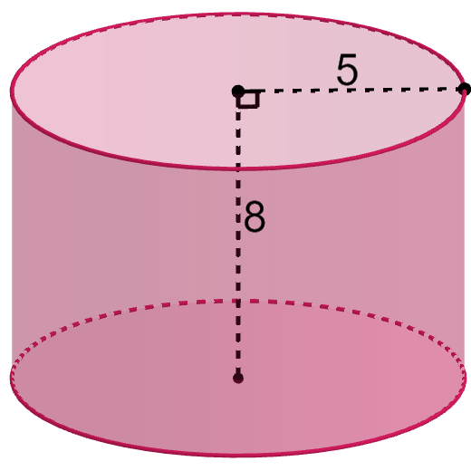
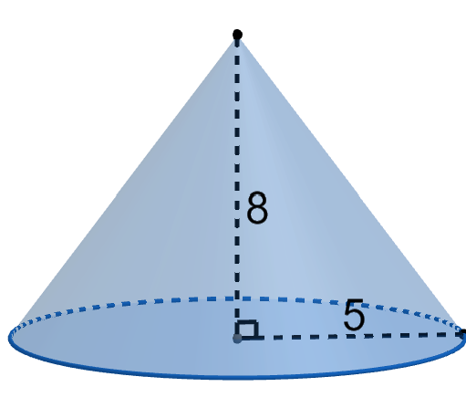
9.6.2 Guided Instruction: Finding Volume
A cone and cylinder are shown, where the radius of the base of each is $5$ units and the height of each is $8$ units.
Cone | Cylinder
volume 2, pg. 83

Slide 9

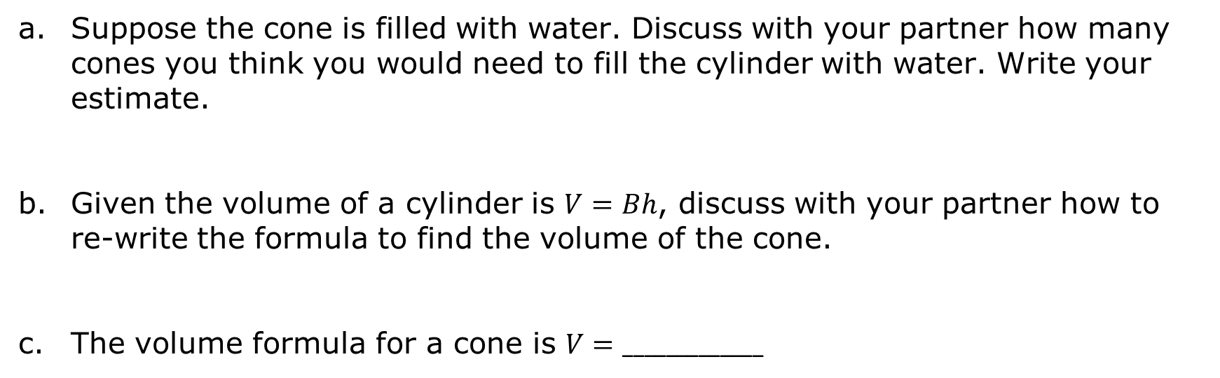
Suppose the cone is filled with water. Discuss with your partner how many cones you think you would need to fill the cylinder with water. Write your estimate.
Given the volume of a cylinder is $V=Bh$, discuss with your partner how to re-write the formula to find the volume of the cone.
The volume formula for a cone is $V=_____________$
A cone is a three-dimensional figure with a circular base and an apex that is connected to the base by a collection of line segments that form a curved surface.
volume 2, pg. 83

Slide 10
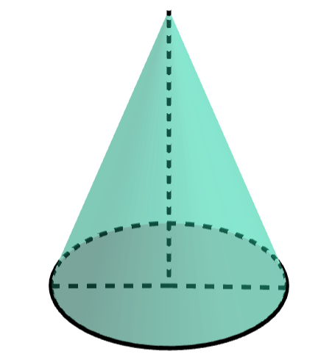

A cone is shown with a diameter of $16$ millimeters (mm), a height of $22$ mm, and a slant height of $23.4$ mm.
Determine the volume of the cone, in terms of $π$.
volume 2, pg. 84

Slide 11
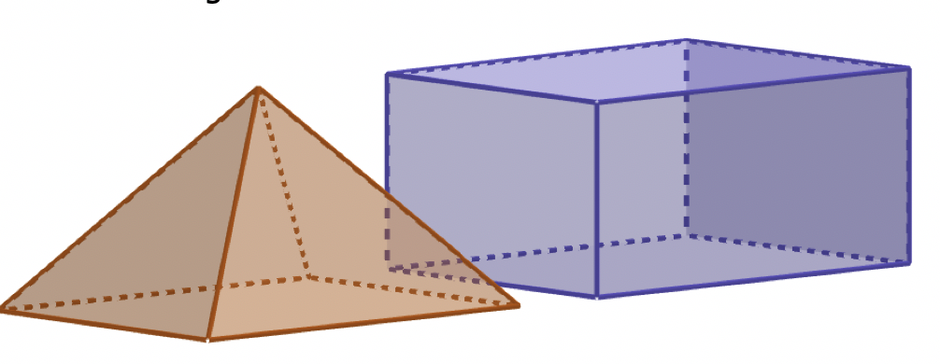
The bases of the rectangular pyramid and rectangular prism shown have congruent bases, and each has the same height.
volume 2, pg. 84

Slide 12
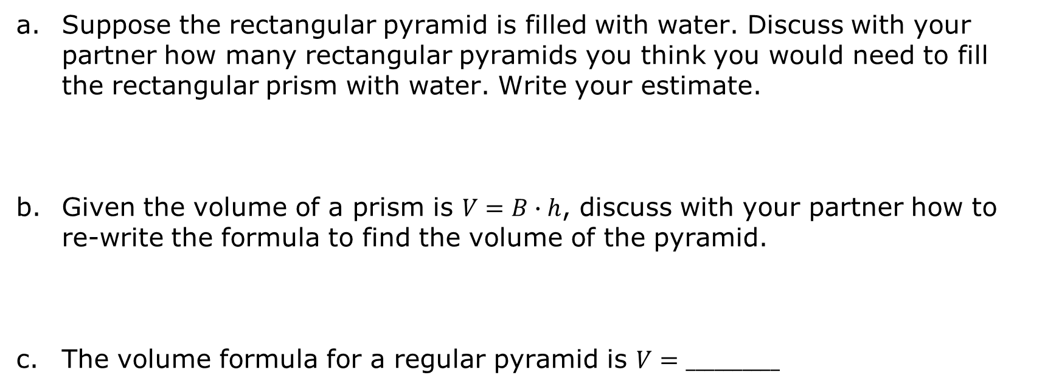
Suppose the rectangular pyramid is filled with water. Discuss with your partner how many rectangular pyramids you think you would need to fill the rectangular prism with water. Write your estimate.
Given the volume of a prism is $V=B∙h$, discuss with your partner how to re-write the formula to find the volume of the pyramid.
The volume formula for a regular pyramid is $V=__________$
volume 2, pg. 84

Slide 13
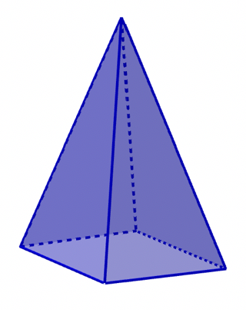
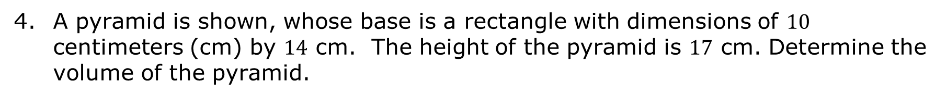
A pyramid is a figure with a polygonal base and triangular faces. The triangular faces have the same size and shape and they connect the sides of the base to a common point called the apex.
A pyramid is shown, whose base is a rectangle with dimensions of $10$ centimeters (cm) by $14$ cm. The height of the pyramid is $17$ cm. Determine the volume of the pyramid.
volume 2, pg. 85

Slide 14
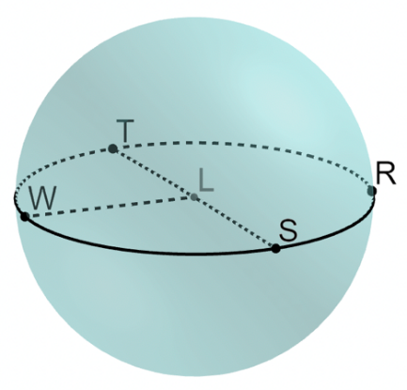
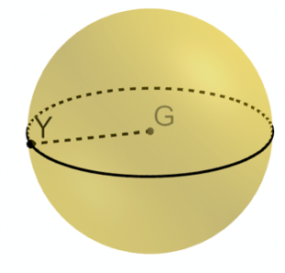
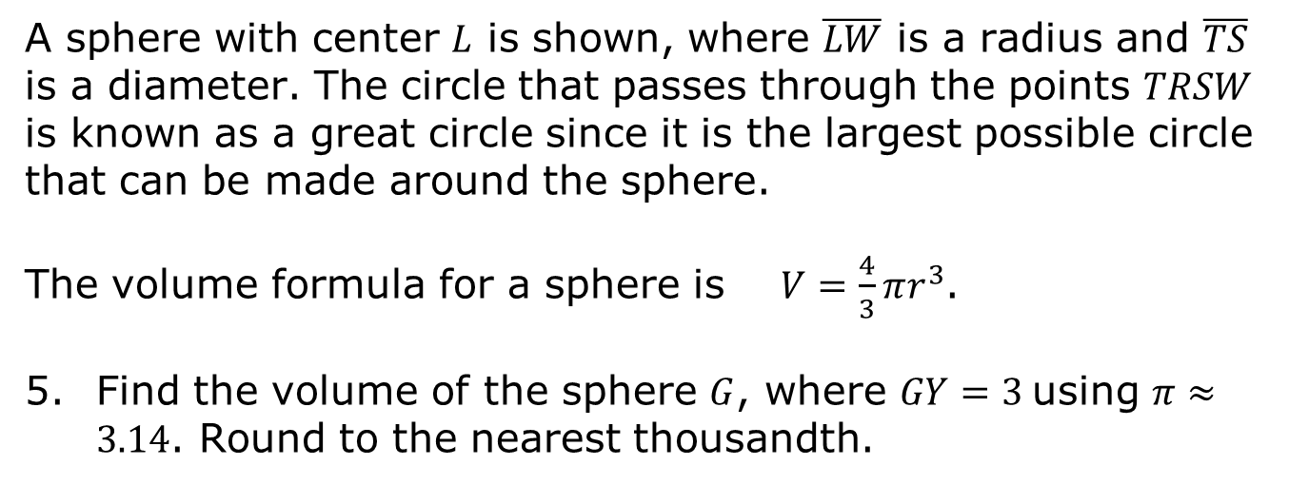
A sphere is a three-dimensional figure, where all points are equidistant from a point called the center.
A sphere with center $L$ is shown, where $\overline{LW}$ is a radius and $\overline{TS}$ is a diameter. The circle that passes through the points $TRSW$ is known as a great circle since it is the largest possible circle that can be made around the sphere.
The volume formula for a sphere is $V=\frac{4}{3}πr^{3}$.
Find the volume of the sphere $G$, where $GY=3$using $π≈3.14$. Round to the nearest thousandth.
volume 2, pg. 85

Slide 15
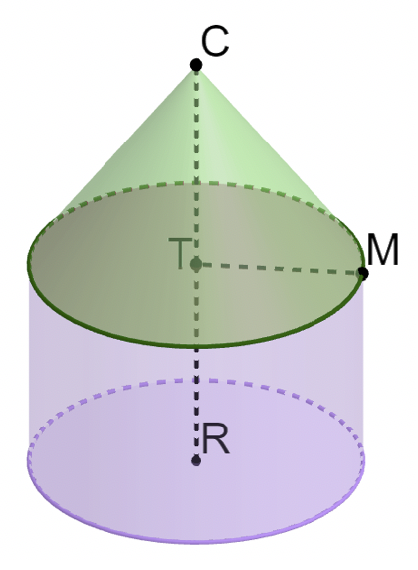
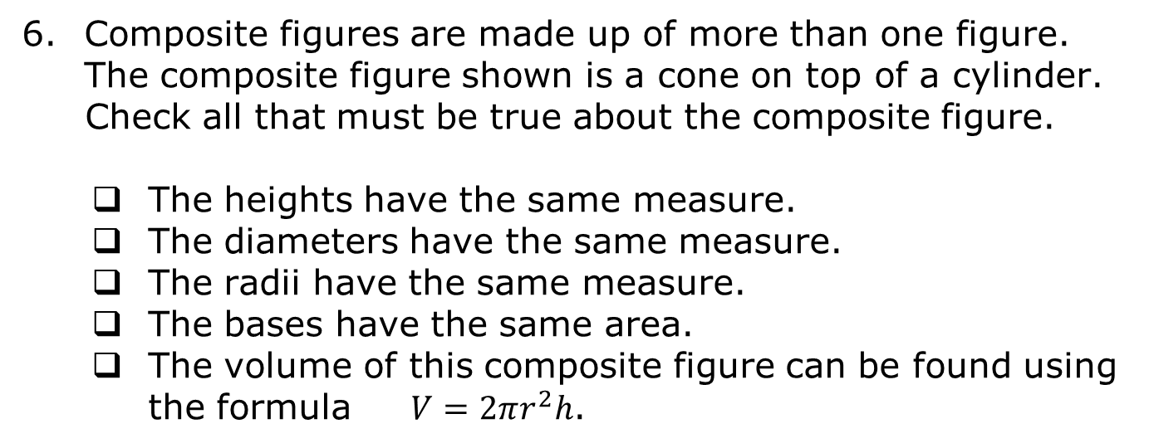
Composite figures are made up of more than one figure. The composite figure shown is a cone on top of a cylinder.
Check all that must be true about the composite figure.
The heights have the same measure.
The diameters have the same measure.
The radii have the same measure.
The bases have the same area.
The volume of this composite figure can be found using the formula $V=2πr^{2}h$.
Discuss with your partner the statements that were false. Rewrite each false statement so that it would be true.
volume 2, pg. 86

Slide 16
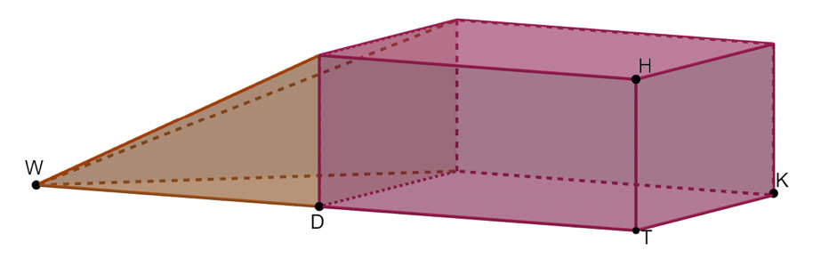
A composite figure is shown, where $HT=3.2$, $KT=4.8$, $DT=10.7$, and $WD=11.1$. $WD$ is the height of the pyramid. Find the volume of the composite figure.
volume 2, pg. 86

Slide 17

Guided Practice
volume 2, pg. 87

Slide 18

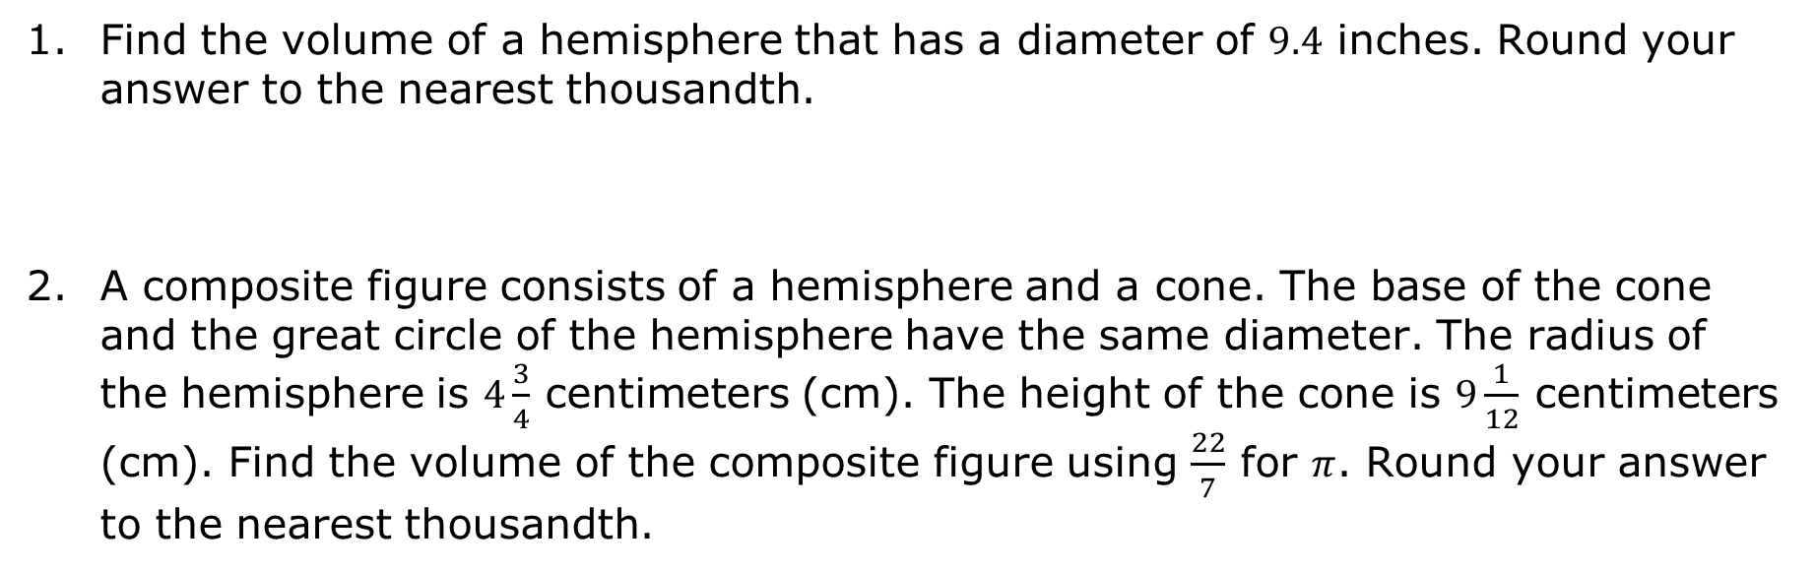
9.6.3 Guided Practice: Finding Volume
Find the volume of a hemisphere that has a diameter of $9.4$ inches. Round your answer to the nearest thousandth.
A composite figure consists of a hemisphere and a cone. The base of the cone and the great circle of the hemisphere have the same diameter. The radius of the hemisphere is $4\frac{3}{4}$ centimeters (cm). The height of the cone is $9\frac{1}{12}$ centimeters (cm). Find the volume of the composite figure using $\frac{22}{7}$ for $π$. Round your answer to the nearest thousandth.
volume 2, pg. 87

Slide 19

Your Turn
volume 2, pg. 87

Slide 20
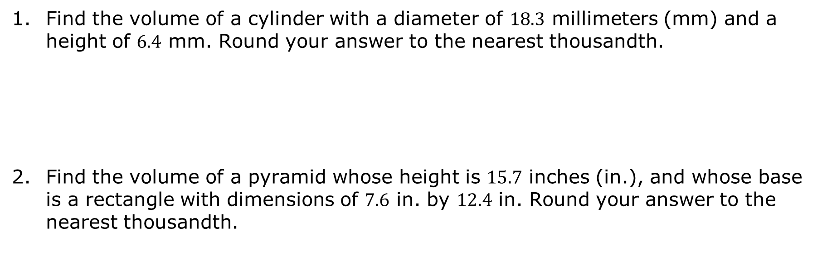
9.6.4 Your Turn!
Find the volume of a cylinder with a diameter of $18.3$ millimeters (mm) and a height of $6.4$ mm. Round your answer to the nearest thousandth.
Find the volume of a pyramid whose height is $15.7$ inches (in.), and whose base is a rectangle with dimensions of $7.6$ in. by $12.4$ in. Round your answer to the nearest thousandth.
volume 2, pg. 87

Slide 21

Wrap-Up
volume 2, pg. 88

Slide 22
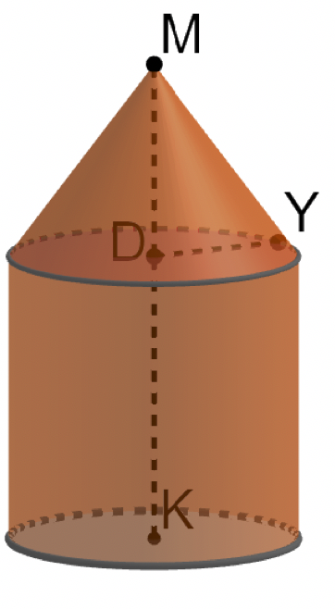
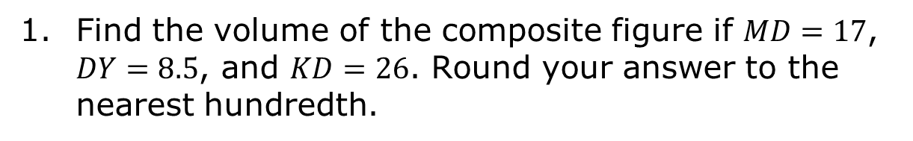
9.6.5 Wrap-Up: Ticket Out the Door
Find the volume of the composite figure if $MD=17$, $DY=8.5$, and $KD=26$. Round your answer to the nearest hundredth.
volume 2, pg. 88

